Slide 1


Tübitak modeling crude oil volatility and returns

Slide 2
İÇERİK
1. HEDGİNG OTOMATİON? ı
2sTATTISTICAL BEHAVOUR OF COMMODITY
3. WHAT ARE MAIN SOURCES OF SIGNALS?
4. How hedging signals can be converted into strategies?
5. A draft hedging procedutre

Slide 3
Outline
Forecasting Crude oil volatility
What determines the crude volatility
What determines the crude oil yield curve change: slope negative or positive?
is there a regime change in crude oil volatility
is there a risk premium in crude oil volatility?
Vol mean reversion
Timing for hedging
Summary

Slide 4
data
Target: RV, VRP, forward curve switching
Macro Fed
Sentiment
Political
Market induced: VIX, OVX, C03, CO6
Sentiment refinitve
Hedgers vs speculators
Cftc net pozisyon (only after 2010)

Slide 5
Mean Reversion: Vasicek (Ornstein Uhlenbeck)
Sürecinin Tahmini ve Simülasyonu
1. Neden ortalamaya dönüş?

Slide 6
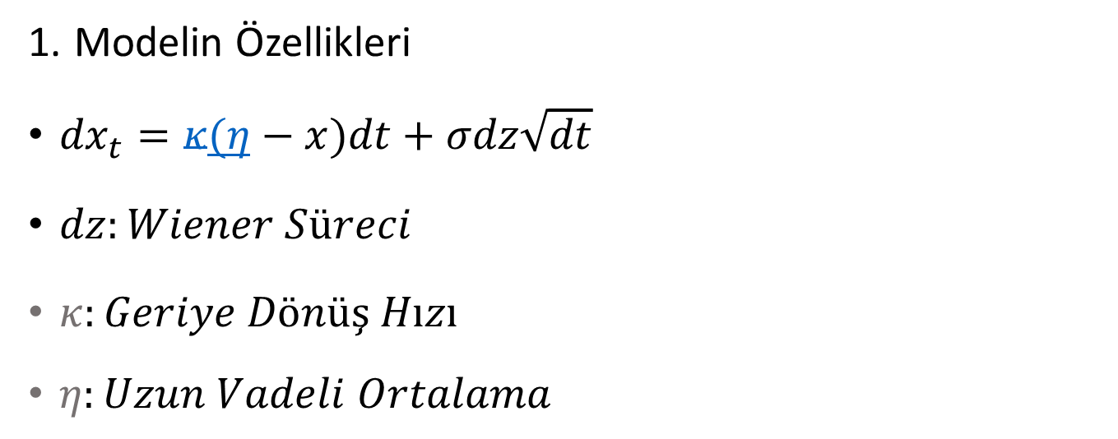
Vasicek
Modelin Özellikleri
${dx}_{t}=κ(η−x)dt+σdz\sqrt{dt}$
$dz:Wiener Süreci$
$κ:Geriye Dönüş Hızı$
$η:Uzun Vadeli Ortalama$

Slide 7
İÇERİK
1. Şirket Tanıtımı
2. İş İhtiyaçları
3. Teklif Kapsamı
4. Fiyat Teklifi
5. Proje Yönetimi

Slide 8
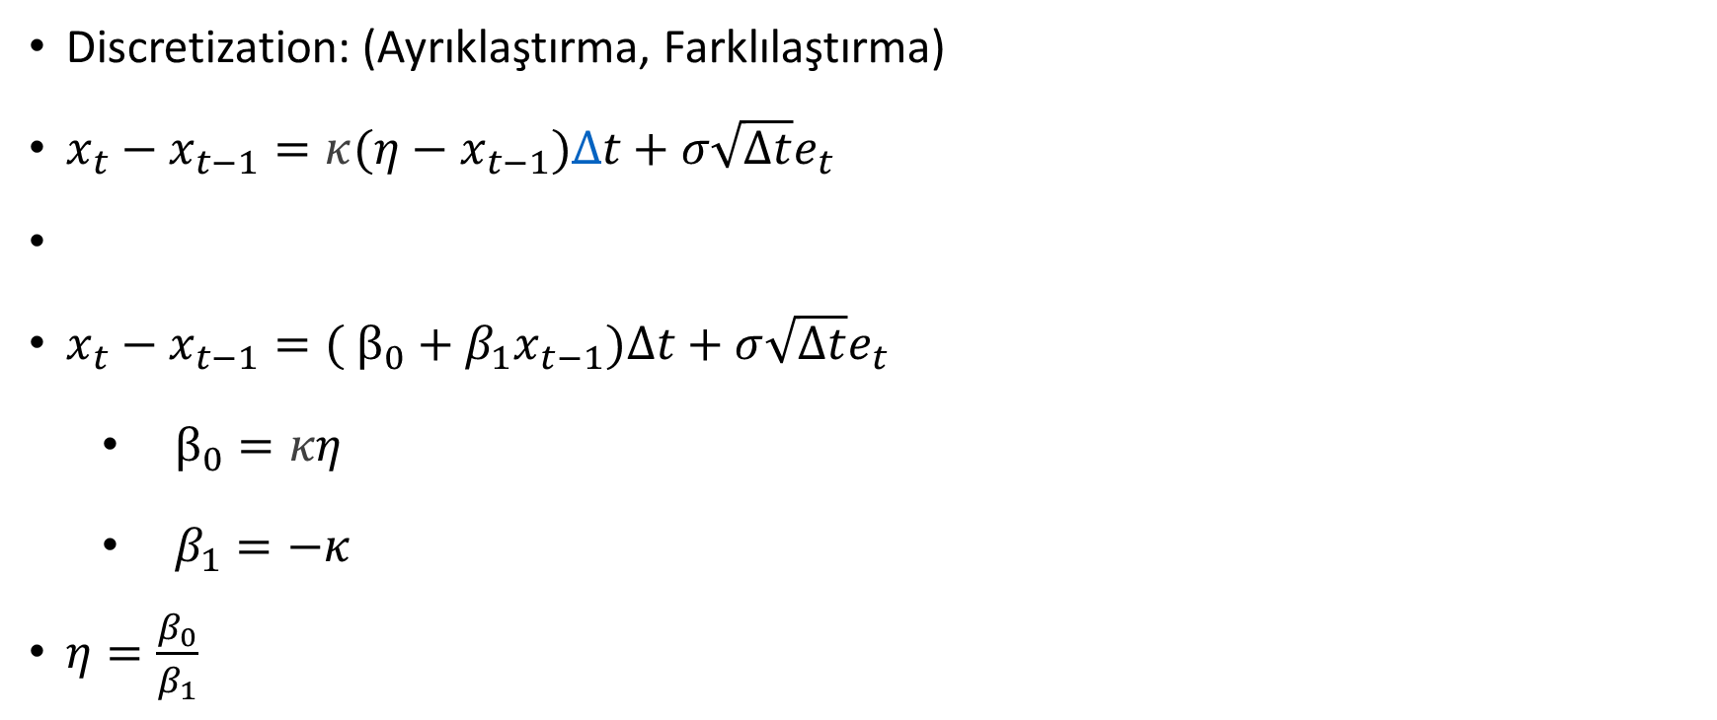
Modelleme
Discretization: (Ayrıklaştırma, Farklılaştırma)
$x_{t}−x_{t−1}=κ(η−x_{t−1})∆t+{σ\sqrt{∆t}e}_{t}$
$x_{t}−x_{t−1}=( β_{0}+β_{1}x_{t−1})∆t+{σ\sqrt{∆t}e}_{t}$
$β_{0}=κη$
$β_{1}=−κ$
${η=\frac{β_{0}}{β_{1}}}_{}$

Slide 9
Ortalamaya Dönüş Süreç Tahmin ve Simülasyon Örnekleri

Slide 10
Örnekler
Ham Petrol

Slide 11
Örnek: Ham Petrol (Brent:CO1) Günlük Veriler (1988-2018)
Günlük Brent Getirileri
Ortalama | 0.007977
Maksimum | 10.15000
Minimum | -10.50000
Std. Sapma | 1.086331
Skewness | -0.366718
Kurtosis | 12.16607
Gözlem Sayısı | 7670

Slide 12
Günlük Brent

Slide 13
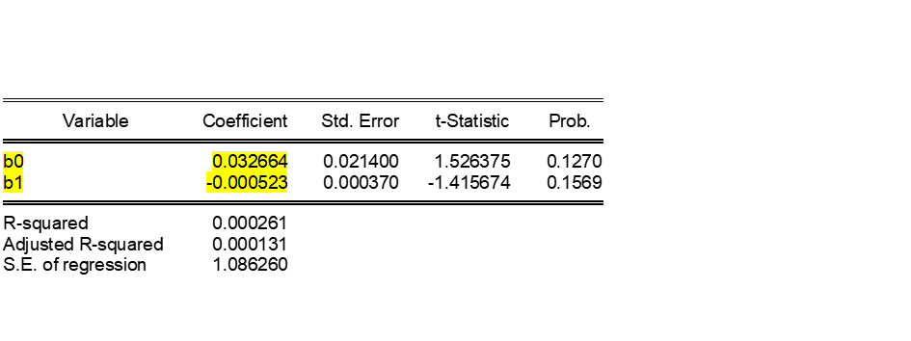
Model Tahmini
Ekonometrik tahmin sonuçları
Brent

Slide 14
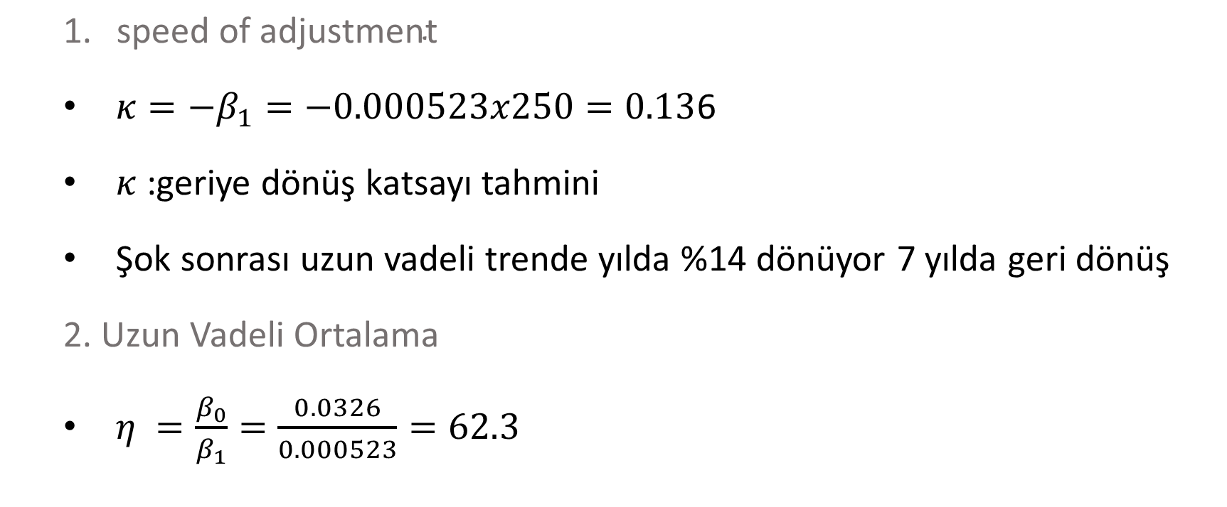
Model Çözümü
$\text{speed} \text{of} \text{adjustment}$
$κ=−β_{1}=−0.000523x250=0.13$6
$κ$ :geriye dönüş katsayı tahmini
Şok sonrası uzun vadeli trende yılda %14 dönüyor 7 yılda geri dönüş
2. Uzun Vadeli Ortalama
$η =\frac{β_{0}}{β_{1}}=\frac{0.0326}{0.000523}=62.3$

Slide 15
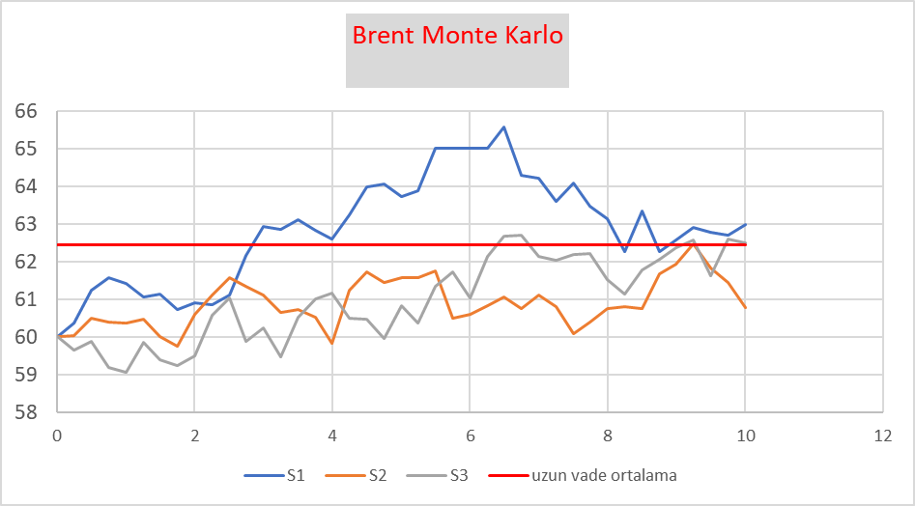
Örnek Simülasyon 1
Brent baslangiç değeri: 60
Uyum %14
Vol gunlük %1.08

Slide 16
Örnek Simülasyon 2
Brent baslangi değeri: 60 Uyum %13 Vol gunlük %2.0

Slide 17
Uzun Vadeye Yakınsama Hızı
Hızlı Yakınsama
Yavaş Yakınsama

Slide 18
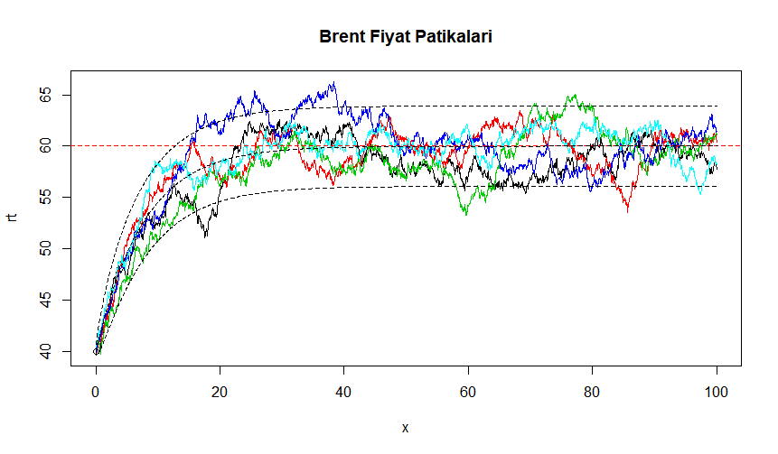
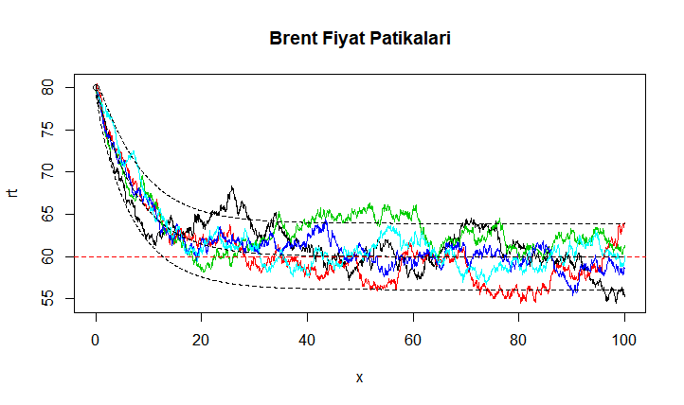
2 st. Sapma aralığında
Başlangıç 40
Başlangıç 80

Slide 19
Standart Volatilite Tahmini
S: spot fiyat,
r_{i} =(S_{i}-S_{i-1})/S_{i-1} (veya r_{i}= ln(S_{i}/S_{i-1}))

Slide 20
Tarihsel Volatilite ve Volatilite konisi

Slide 21
Ham Petrol (Brent)

Slide 22
3 ay vadeli $/TL Volatilitesi (implied)

Slide 23
3 ay Vadeli ABD Hazine Faizi Ortalama %4.7 (1973-2018)

Slide 24
İn this study (2009-2022 monthly data)
Markov regime shifts and realized volatilty
Fitting a vasicek model for Crude RV
Forecasting the RV by using Market implied methods:
Vol skew
Implied vol
Term structure of IV
Term structure of crude forward curve
Forecasting RV with large macro and sentiment data

Slide 25
CORPORATE HEDGING

Slide 26
CORPORATE HEDGİNG
Carter, Rogers and Simkins (2006a, 2006b) evaluate the hedging behavior of U.S.
airlines between 1992 and 2003 and conclude jet-fuel hedging is positively related to market values.
Four major aspects influence the airline’s
hedging decision: (i) The firm’s financial strength and its current credit rating,
(ii) its price and quantity correlations,
(iii) fixed and variable transaction costs, and (iv) the firm’s risk
profile

Slide 27
CORPORATE HEDGİNG
An additional critical aspect is the strong seasonal variation in demand, especially
within the passenger transportation sector, with a peak during the summer months June, July and August
the airline’s considerations of price and quantity correlations as well
as hedging costs play also a significant role in the firm’s choice of derivative contracts
Average option has advantages since daily average exposures makes it suitable for hedging and average decreases the volatilty.
The company considers 20 different scenarios
assuming a constant oil price ranging from $10 to $200 per barrel of oil.
In backtesting: first-order stochastic dominant hedging portfolio

Slide 28
İdeas and issues on commodity hedge optimization
Mean reversion implied volatility
Regime switching with hedging (futures optimality) (Gaussian mixtures though nonlinearity in finance is an issue)
Regime switching and optimal hedge ratio (MS Regime switching)
Exposure and price uncertainty
VaR based optimization
DT or RF model to see the regimes
when to choose collar vs linear positions (forwards and swaps)
the airline exhibits a positive price-quantity correlation: During
times of strong economic conditions both the demand for flights and the prices for kerosene
tend to increase. The reverse typically holds during a recessioN

Slide 29
Modelling issues
First if the A: IV RV difference, B: IV-LT mean difference, if a threshold like z score, (t could be weekly, or monthly),

Slide 30
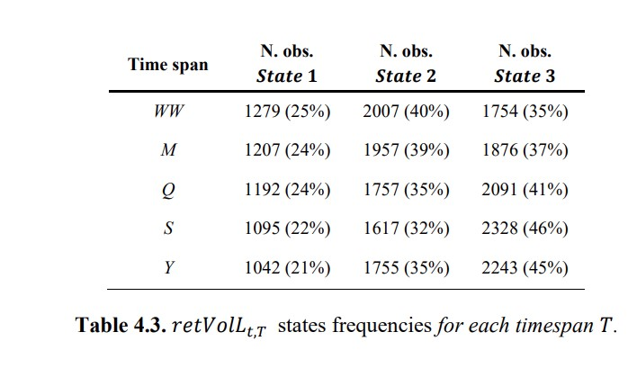
States (vol+return combinations)
In the three-state return and volatility trend regimes representation, the outcome is represented
by the combination of the previous characterizations:
(i) negative return and positive volatility
trend;
(ii) positive return and positive volatility trend, or negative return and negative volatility
trend;
or (iii) positive return and negative volatility trend

Slide 31
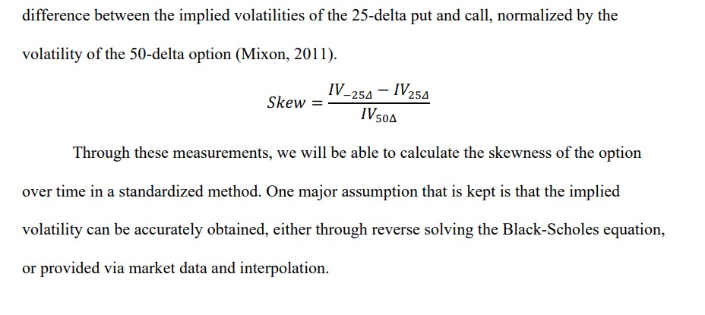
Vol skew
Options skews have been decent contrary indicators of future price direction over the past decade. CME(2022)
In most cases a correlation of over 90 percent implied volatility and underlying are inversely correlated, which means that if underlying goes up, IV comes down or quotes mostly at a lower bound, and if the underlying starts correcting, IV shoots up

Slide 32
Vol skew
Forecasts using IV skew
The shape of the IV Skew keeps changing with changing market conditions and can broadly be categorised in four regimes.
1. Flattening IV skew: A flattening of IV skew means that the right and the left wing of the “U” shaped IV skew tends to flatten to become a more horizontal curve. This phenomenon generally means that underlying is comfortably bullish and, in most cases, moving up with a marginal positive drift.
2. Steepening IV skew: This happens when the wings of the “U” shaped IV skew starts looking more like a “V”. It will happen when both Call and Puts writers are nervous in writing options and want an extraordinary compensation to sell options, be it calls or puts.This can also happen due to excessive demand of OTM calls and puts which means the market expectation is of a big move either way. A regime like this generally invites a trend reversal—if the underlying was correcting, it may rebound upwards or if it's moving up, it may witness correction.
3. Left steepening of IV skew: Left steepening means that IV of OTM Puts is increasing at a faster pace. This happens when there is a very high demand of OTM Puts for direction or hedging and these trades are mostly right.
The increase in IV can also be because option writers are sceptical of writing puts as they also expect a higher risk of a fall. In either case, the net forecasting outcome is that if the underlying has a high probability of a fall and if the prices haven’t corrected already, there is a significant chance of a fall.
4. Right steepening of IV skew: This is an extremely rare formation because if the market goes up, the IV level itself will start reducing and this will kill the forecasting benefit due to skew. If the right wing is steepening, this could be a result of an expectation of some unforeseen event. Hence, this formation might not be feasible and should be ignored for a trade.

Slide 33
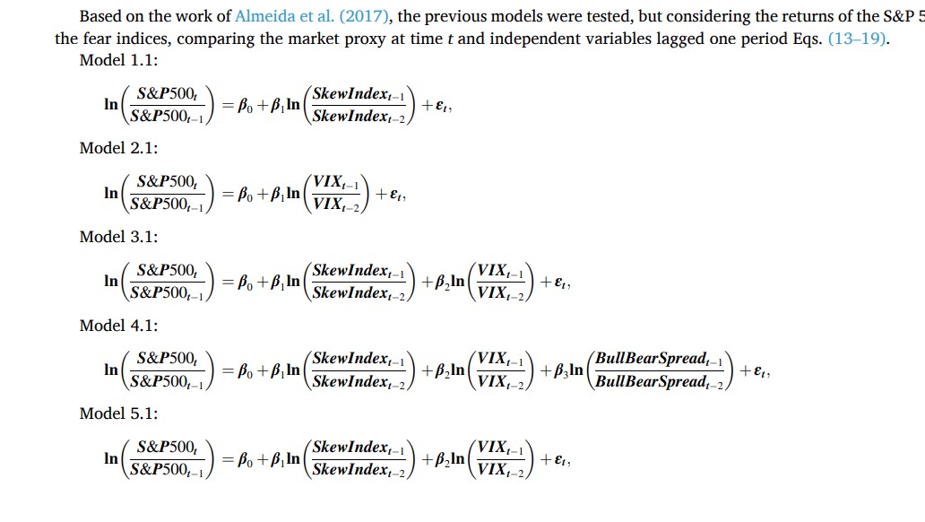

Slide 34
The second strand of oil price forecasting literature states that oil price forecasts might be biased if one omits the
impacts of the macro economy and financial markets, therefore pays particular attention to the ability of macroeconomic
and financial variables, including economic activity [17], financial market information [18,19], fluctuations in exchange
rates [20,21], macro and financial uncertainty [3,22], investor attention [23], the news-based economic volatility [24,25],
speculative shocks [26], geopolitical conflicts [7]

Slide 35
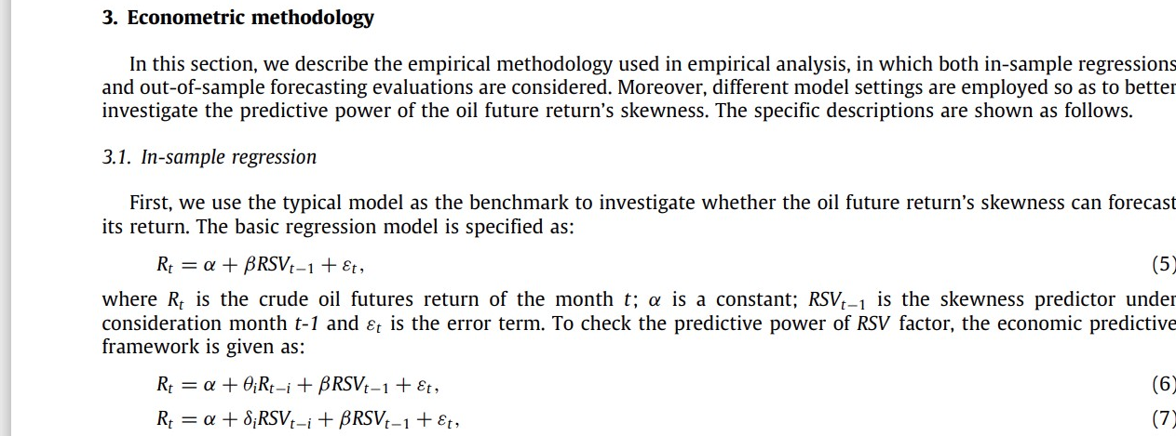
Return and vol skew:RSV realized skewed

Slide 36
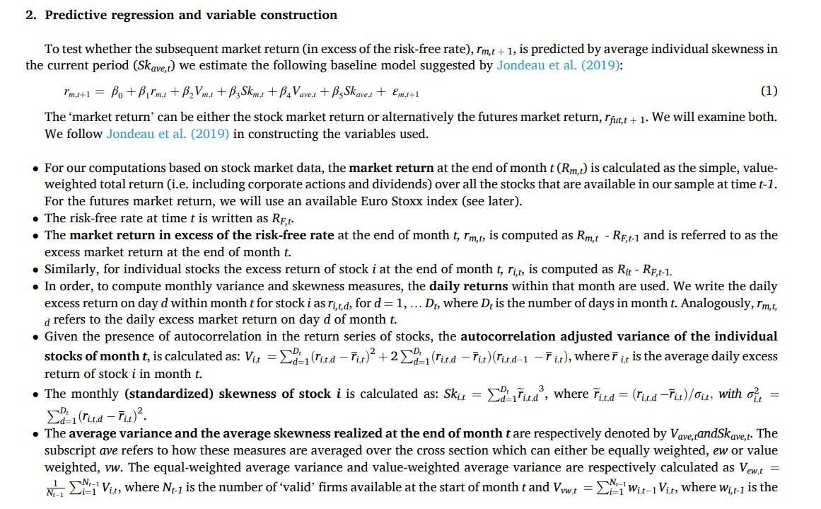

Slide 37
I test my prediction using a probit regression, with the dependent variable equal to 1
when earnings announcement returns are less than or equal to -10%, and 0 when earnings
announcement returns are greater than -10%. The independent variables are defined as follows:
Skew: The difference between out-of-the-money put option implied
volatility and at-the-money call option implied volatility
ATM IV: Implied volatility of at-the-money options
Log(Market Value): Natural logarithm of market value of equity

Slide 38
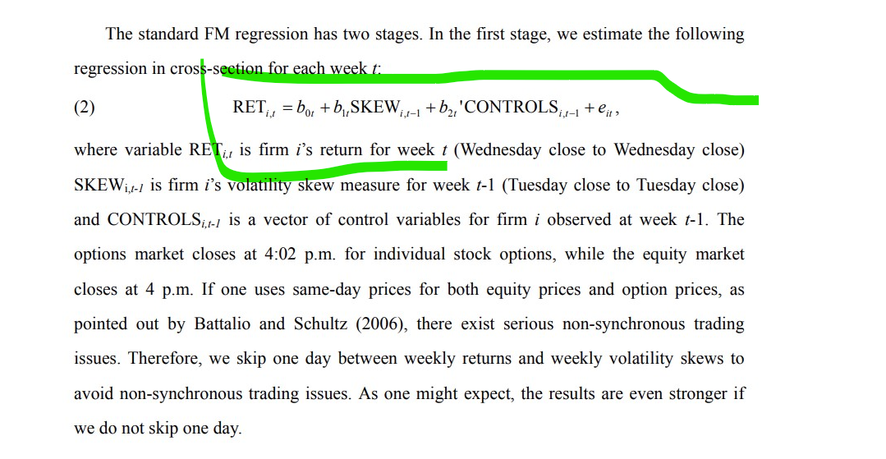

Slide 39
S. Gilbert, S.K. Jones, G.H. Morris The impact of skewness in the hedging decision
Journal of Futures Markets, 26 (5) (2006), pp. 503-520

Slide 40
Crude volatility forecasts
VIX; Infectious Disease Tracking Index, IDEMV), economic policy conditions (Economic Policy Uncertainty Index, EPU; Geopolitical Risk Index,
GPR
FED 122 macro variables

Slide 41
Potential research
FEATURES
 |  | macro |  | sentiment |  | political |  | futures |  | skew (IV,RV) |  | Regime switching
return
IV
RV
TARGET

Slide 42
Crude Oil Realized Volatility forecast
Model | model RV | R-adj | difference from benchmark
RV autoregressive | benchmark RV | 0.623 | 0
Forward Curve Slope | CO31,CO63 | 0.626 | 0.003
Forward Curve Slope | CO63 | 0.625 | 0.002
Implied Skew | 25RR30,60,90 | 0.641 | 0.018
Implied Skew | 25RR30,60 | 0.632 | 0.009
Implied Skew | 25RR30 | 0.63 | 0.007
Implied Skew | 25RR60 | 0.627 | 0.004
Imp. Volatility term spread | vol180_30,60_30,90_30 | 0.714 | 0.091
Imp. Volatility term spread | vol180_30 | 0.709 | 0.086
Imp. Volatility term spread | vol_60_30 | 0.684 | 0.061
Imp. Volatility term spread | vol_90_30 | 0.691 | 0.068

Slide 44
Futures and oil forecasts
A lot of discussions on the slope of forward curve to predict the oil prices
Crack spread futures can be used to forecast oil prices.
Some variables:

Slide 45
RV

Slide 46
Forecastin RV and other: benchmark
 | coef | t | P>|t|
intercept | 4.9623 | 0.003 | 1.724
RV30lag1 | 0.6294 | 0 | 0.482
RV30lag2 | 0.2477 | 0.007 | 0.069
RV30lag3 | -0.0406 | 0.419 | -0.14
R-squared: | 0.63
R-squared: | 0.623

Slide 47
Can IV terms structure improve RV forecast?
 | coef | std | P>|t|
intercept | 10.2834 | 1.634 | 0
RV30lag1 | 0.3922 | 0.073 | 0
RV30lag2 | 0.1787 | 0.08 | 0.027
RV30lag3 | 0.002 | 0.044 | 0.964
vol180_30 | -2.4838 | 0.683 | 0
vol60_30 | 0.1154 | 2.291 | 0.96
vol90_30 | 2.303 | 1.996 | 0.25
R-squared: | 0.725
R-squared: | 0.714
 | coef | std | P>|t|
intercept | 9.2144 | 5.478 | 0
RV30lag1 | 0.4701 | 6.341 | 0
RV30lag2 | 0.2157 | 2.598 | 0.01
RV30lag3 | -0.0119 | -0.258 | 0.8
vol60_30 | -2.6234 | -5.592 | 0
0.699
0.691
intercept | 10.3911 | 1.641 | 6.33 | 0
RV30lag1 | 0.4132 | 0.073 | 5.68 | 0
RV30lag2 | 0.1877 | 0.08 | 2.35 | 0.02
RV30lag3 | -0.0012 | 0.044 | -0.03 | 0.979
vol180_30 | -1.1221 | 0.163 | -6.89 | 0
R-squared: | 0.716
 | 0.709
 | coef | se | p
intercept | 9.7497 | 5.785 | 0
RV30lag1 | 0.457 | 6.215 | 0
RV30lag2 | 0.2018 | 2.454 | 0.015
RV30lag3 | -0.0087 | -0.19 | 0.85
vol90_30 | -1.6939 | -5.976 | 0

Slide 48
Impact of implied skew
intercept | 4.2632 | 1.736 | 2.456 | 0.015
RV30lag1 | 0.5577 | 0.076 | 7.294 | 0
RV30lag2 | 0.2363 | 0.089 | 2.668 | 0.008
RV30lag3 | -0.0223 | 0.049 | -0.45 | 0.653
25RR_30 | -3.7881 | 1.385 | -2.736 | 0.007
25RR_60 | 6.9084 | 2.671 | 2.587 | 0.011
25RR_90 | -3.89 | 1.755 | -2.216 | 0.028
R-squared: | 0.655
R-squared: | 0.641
 | coef | std | t
intercept | 5.3857 | 1.681 | 0.002
RV30lag1 | 0.5963 | 0.075 | 0
RV30lag2 | 0.2362 | 0.09 | 0.009
RV30lag3 | -0.0379 | 0.05 | 0.446
25RR_30 | -1.9852 | 1.134 | 0.082
25RR_60 | 1.5348 | 1.134 | 0.178
R-squared: | 0.644
R-squared: | 0.632
 | coef | t
intercept | 4.784 | 2.942 | 0.004
RV30lag1 | " | 7.925 | 0
RV30lag2 | 0.2338 | 2.601 | 0.01
RV30lag3 | -0.0414 | -0.834 | 0.406
25RR_30 | -0.4833 | -2.027 | 0.044
0.639
0.63
 |  | coef | std | t
intercept | 4.6576 | 1.64 | 2.84 | 0.005
RV30lag1 | 0.6051 | 0.076 | 7.991 | 0
RV30lag2 | 0.2357 | 0.09 | 2.611 | 0.01
RV30lag3 | -0.0422 | 0.05 | -0.846 | 0.399
25RR_60 | -0.4047 | 0.239 | -1.692 | 0.093
 |  | 0.636
 |  | 0.627

Slide 49
İmpact of crude forward slope
 |  | coef | t | p
 | intercept | 4.808 | 2.863 | 0.005
 | RV30lag1 | 0.6315 | 8.349 | 0
 | RV30lag2 | 0.2673 | 2.936 | 0.004
 | RV30lag3 | -0.0496 | -0.979 | 0.329
 | CO31 | 2.3344 | 1.313 | 0.191
 | CO63 | -1.5143 | -0.982 | 0.328
R-squared: | 0.638
R-squared: | 0.626
 | coef | std | P>|t|
intercept | 5.2498 | 3.183 | 0.002
RV30lag1 | 0.6178 | 8.227 | 0
RV30lag2 | 0.2498 | 2.767 | 0.006
RV30lag3 | -0.0383 | -0.765 | 0.446
CO63 | 0.4607 | 1.35 | 0.179
R-sq: 0.634
R sq_ad: 0.625

Slide 50
More data
Put call ration in crude oil
Position of hedgers and speculators
Distribution of RV.
distribution of RV for various VIX levels 20 30 40 etc.
mean reversion with returns can be tried.

Slide 51




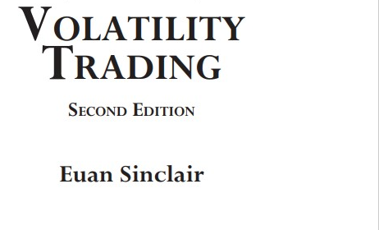
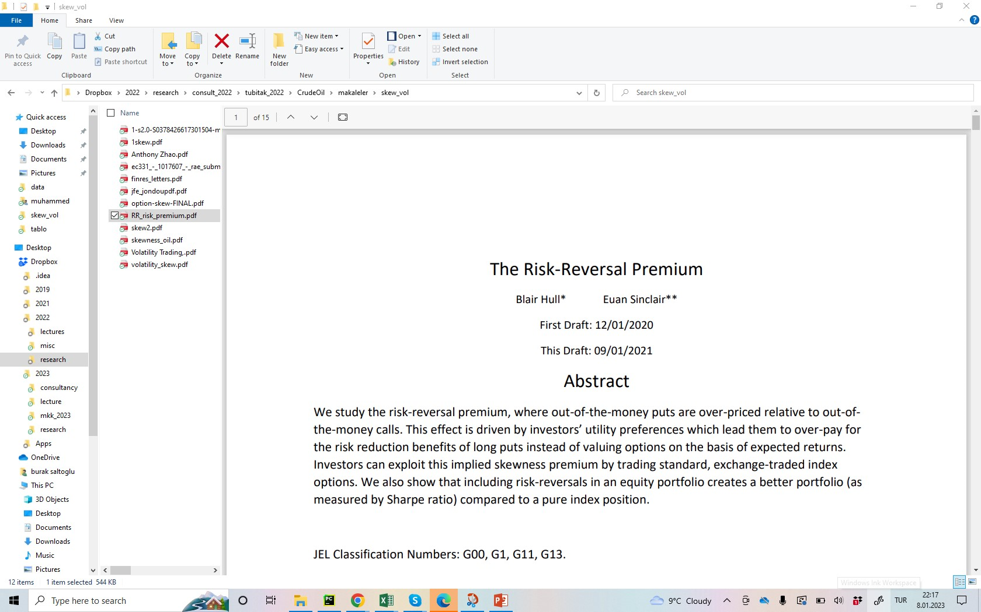
Volatility trading and options

Slide 52
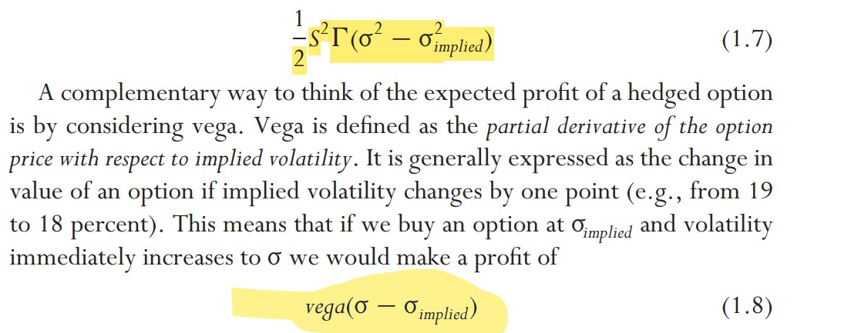
Vol forecasting and hedging
Mean reversion: practice
IV and RV mean reversion:
Reverting to mean takes 3-12 months

Slide 53
RV IV relationship
İf RV>IV => option price is cheaper rel. To vol. So long in option is more preferrable
RV<IV it might be important to reduce the hedge position.

Slide 54
Use or RR25
Promoting the use of RR within a contrarian context, J. P. Morgan (2000)
presented their approach as follows: “For risk reversals, we follow the
common practice of treating positive and negative observations differently -
for instance, a high positive value is seen in the context of just positive
observations, rather than the whole distribution. [...] we build a one standarddeviation band around two different means and literally disregard anything
that is inside it. [...] When [risk reversals] are at an unusually high or low level
then you extract value out of it... and you go against them. The skew is two
large hence the risk is that the currency actually moves in the opposite
direction. “

Slide 55
CORPORATE HEDGING

Slide 56
CORPORATE HEDGİNG
Carter, Rogers and Simkins (2006a, 2006b) evaluate the hedging behavior of U.S.
airlines between 1992 and 2003 and conclude jet-fuel hedging is positively related to market values.
Four major aspects influence the airline’s
hedging decision: (i) The firm’s financial strength and its current credit rating,
(ii) its price and quantity correlations,
(iii) fixed and variable transaction costs, and (iv) the firm’s risk
profile

Slide 57
CORPORATE HEDGİNG
An additional critical aspect is the strong seasonal variation in demand, especially
within the passenger transportation sector, with a peak during the summer months June, July and August
the airline’s considerations of price and quantity correlations as well
as hedging costs play also a significant role in the firm’s choice of derivative contracts
Average option has advantages since daily average exposures makes it suitable for hedging and average decreases the volatilty.
The company considers 20 different scenarios
assuming a constant oil price ranging from $10 to $200 per barrel of oil.
In backtesting: first-order stochastic dominant hedging portfolio

Slide 58
İdeas and issues on commodity hedge optimization
Mean reversion implied volatility
Regime switching with hedging (futures optimality) (Gaussian mixtures though nonlinearity in finance is an issue)
Regime switching and optimal hedge ratio (MS Regime switching)
Exposure and price uncertainty
VaR based optimization
DT or RF model to see the regimes
when to choose collar vs linear positions (forwards and swaps)
the airline exhibits a positive price-quantity correlation: During
times of strong economic conditions both the demand for flights and the prices for kerosene
tend to increase. The reverse typically holds during a recessioN

Slide 59
Modelling issues
First if the A: IV RV difference, B: IV-LT mean difference, if a threshold like z score, (t could be weekly, or monthly),

Slide 60
States (vol+return combinations)
In the three-state return and volatility trend regimes representation, the outcome is represented
by the combination of the previous characterizations: (i) negative return and positive volatility
trend; (ii) positive return and positive volatility trend, or negative return and negative volatility
trend; or (iii) positive return and negative volatility trend

Slide 61
Vol skew
Options skews have been decent contrary indicators of future price direction over the past decade. CME(2022)
In most cases a correlation of over 90 percent implied volatility and underlying are inversely correlated, which means that if underlying goes up, IV comes down or quotes mostly at a lower bound, and if the underlying starts correcting, IV shoots up

Slide 62
Vol skew
Forecasts using IV skew
The shape of the IV Skew keeps changing with changing market conditions and can broadly be categorised in four regimes.
1. Flattening IV skew: A flattening of IV skew means that the right and the left wing of the “U” shaped IV skew tends to flatten to become a more horizontal curve. This phenomenon generally means that underlying is comfortably bullish and, in most cases, moving up with a marginal positive drift.
2. Steepening IV skew: This happens when the wings of the “U” shaped IV skew starts looking more like a “V”. It will happen when both Call and Puts writers are nervous in writing options and want an extraordinary compensation to sell options, be it calls or puts.This can also happen due to excessive demand of OTM calls and puts which means the market expectation is of a big move either way. A regime like this generally invites a trend reversal—if the underlying was correcting, it may rebound upwards or if it's moving up, it may witness correction.
3. Left steepening of IV skew: Left steepening means that IV of OTM Puts is increasing at a faster pace. This happens when there is a very high demand of OTM Puts for direction or hedging and these trades are mostly right.
The increase in IV can also be because option writers are sceptical of writing puts as they also expect a higher risk of a fall. In either case, the net forecasting outcome is that if the underlying has a high probability of a fall and if the prices haven’t corrected already, there is a significant chance of a fall.
4. Right steepening of IV skew: This is an extremely rare formation because if the market goes up, the IV level itself will start reducing and this will kill the forecasting benefit due to skew. If the right wing is steepening, this could be a result of an expectation of some unforeseen event. Hence, this formation might not be feasible and should be ignored for a trade.

Slide 64
The second strand of oil price forecasting literature states that oil price forecasts might be biased if one omits the
impacts of the macro economy and financial markets, therefore pays particular attention to the ability of macroeconomic
and financial variables, including economic activity [17], financial market information [18,19], fluctuations in exchange
rates [20,21], macro and financial uncertainty [3,22], investor attention [23], the news-based economic volatility [24,25],
speculative shocks [26], geopolitical conflicts [7]

Slide 65
Return and vol skew:RSV realized skewed

Slide 67
I test my prediction using a probit regression, with the dependent variable equal to 1
when earnings announcement returns are less than or equal to -10%, and 0 when earnings
announcement returns are greater than -10%. The independent variables are defined as follows:
Skew: The difference between out-of-the-money put option implied
volatility and at-the-money call option implied volatility
ATM IV: Implied volatility of at-the-money options
Log(Market Value): Natural logarithm of market value of equity

Slide 69
S. Gilbert, S.K. Jones, G.H. Morris The impact of skewness in the hedging decision
Journal of Futures Markets, 26 (5) (2006), pp. 503-520

Slide 70
Crude volatility forecasts
VIX; Infectious Disease Tracking Index, IDEMV), economic policy conditions (Economic Policy Uncertainty Index, EPU; Geopolitical Risk Index,
GPR
FED 122 macro variables

Slide 71
Potential research
FEATURES
 |  | macro |  | sentiment |  | political |  | futures |  | skew (IV,RV) |  | Regime switching
return
IV
RV
TARGET

Slide 73
Futures and oil forecasts
A lot of discussions on the slope of forward curve to predict the oil prices
Crack spread futures can be used to forecast oil prices.
Some variables:

Slide 74
RV

Slide 75
Forecastin RV and other: benchmark
 | coef | t | P>|t|
intercept | 4.9623 | 0.003 | 1.724
RV30lag1 | 0.6294 | 0 | 0.482
RV30lag2 | 0.2477 | 0.007 | 0.069
RV30lag3 | -0.0406 | 0.419 | -0.14
R-squared: | 0.63
R-squared: | 0.623

Slide 76
Can IV terms structure improve RV forecast?
 | coef | std | P>|t|
intercept | 10.2834 | 1.634 | 0
RV30lag1 | 0.3922 | 0.073 | 0
RV30lag2 | 0.1787 | 0.08 | 0.027
RV30lag3 | 0.002 | 0.044 | 0.964
vol180_30 | -2.4838 | 0.683 | 0
vol60_30 | 0.1154 | 2.291 | 0.96
vol90_30 | 2.303 | 1.996 | 0.25
R-squared: | 0.725
R-squared: | 0.714
 | coef | std | P>|t|
intercept | 9.2144 | 5.478 | 0
RV30lag1 | 0.4701 | 6.341 | 0
RV30lag2 | 0.2157 | 2.598 | 0.01
RV30lag3 | -0.0119 | -0.258 | 0.8
vol60_30 | -2.6234 | -5.592 | 0
0.699
0.691
intercept | 10.3911 | 1.641 | 6.33 | 0
RV30lag1 | 0.4132 | 0.073 | 5.68 | 0
RV30lag2 | 0.1877 | 0.08 | 2.35 | 0.02
RV30lag3 | -0.0012 | 0.044 | -0.03 | 0.979
vol180_30 | -1.1221 | 0.163 | -6.89 | 0
R-squared: | 0.716
 | 0.709
 | coef | se | p
intercept | 9.7497 | 5.785 | 0
RV30lag1 | 0.457 | 6.215 | 0
RV30lag2 | 0.2018 | 2.454 | 0.015
RV30lag3 | -0.0087 | -0.19 | 0.85
vol90_30 | -1.6939 | -5.976 | 0

Slide 77
Impact of implied skew
intercept | 4.2632 | 1.736 | 2.456 | 0.015
RV30lag1 | 0.5577 | 0.076 | 7.294 | 0
RV30lag2 | 0.2363 | 0.089 | 2.668 | 0.008
RV30lag3 | -0.0223 | 0.049 | -0.45 | 0.653
25RR_30 | -3.7881 | 1.385 | -2.736 | 0.007
25RR_60 | 6.9084 | 2.671 | 2.587 | 0.011
25RR_90 | -3.89 | 1.755 | -2.216 | 0.028
R-squared: | 0.655
R-squared: | 0.641
 | coef | std | t
intercept | 5.3857 | 1.681 | 0.002
RV30lag1 | 0.5963 | 0.075 | 0
RV30lag2 | 0.2362 | 0.09 | 0.009
RV30lag3 | -0.0379 | 0.05 | 0.446
25RR_30 | -1.9852 | 1.134 | 0.082
25RR_60 | 1.5348 | 1.134 | 0.178
R-squared: | 0.644
R-squared: | 0.632
 | coef | t
intercept | 4.784 | 2.942 | 0.004
RV30lag1 | " | 7.925 | 0
RV30lag2 | 0.2338 | 2.601 | 0.01
RV30lag3 | -0.0414 | -0.834 | 0.406
25RR_30 | -0.4833 | -2.027 | 0.044
0.639
0.63
 |  | coef | std | t
intercept | 4.6576 | 1.64 | 2.84 | 0.005
RV30lag1 | 0.6051 | 0.076 | 7.991 | 0
RV30lag2 | 0.2357 | 0.09 | 2.611 | 0.01
RV30lag3 | -0.0422 | 0.05 | -0.846 | 0.399
25RR_60 | -0.4047 | 0.239 | -1.692 | 0.093
 |  | 0.636
 |  | 0.627

Slide 78
İmpact of crude forward slope
 |  | coef | t | p
 | intercept | 4.808 | 2.863 | 0.005
 | RV30lag1 | 0.6315 | 8.349 | 0
 | RV30lag2 | 0.2673 | 2.936 | 0.004
 | RV30lag3 | -0.0496 | -0.979 | 0.329
 | CO31 | 2.3344 | 1.313 | 0.191
 | CO63 | -1.5143 | -0.982 | 0.328
R-squared: | 0.638
R-squared: | 0.626
 | coef | std | P>|t|
intercept | 5.2498 | 3.183 | 0.002
RV30lag1 | 0.6178 | 8.227 | 0
RV30lag2 | 0.2498 | 2.767 | 0.006
RV30lag3 | -0.0383 | -0.765 | 0.446
CO63 | 0.4607 | 1.35 | 0.179
R-sq: 0.634
R sq_ad: 0.625

Slide 79
Crude Oil Realized Volatility forecast
Model | model RV | R-adj | difference from benchmark
RV autoregressive | benchmark RV | 0.623 | 0
Forward Curve Slope | CO31,CO63 | 0.626 | 0.003
Forward Curve Slope | CO63 | 0.625 | 0.002
Implied Skew | 25RR30,60,90 | 0.641 | 0.018
Implied Skew | 25RR30,60 | 0.632 | 0.009
Implied Skew | 25RR30 | 0.63 | 0.007
Implied Skew | 25RR60 | 0.627 | 0.004
Imp. Volatility term spread | vol180_30,60_30,90_30 | 0.714 | 0.091
Imp. Volatility term spread | vol180_30 | 0.709 | 0.086
Imp. Volatility term spread | vol_60_30 | 0.684 | 0.061
Imp. Volatility term spread | vol_90_30 | 0.691 | 0.068

Slide 80
ÖZET
Beklenen Getiri İstatistik ya da Uzman Görüşü Olabilir.
Kısa, Orta ve Uzun Vade Tahminlerde Doğru Girdilerin Seçimi Çok Önemli.
Faiz, Hisse, Kur ve Emtia Benzerlik ve Ayrılıkları Önemli.
Kısa Vadede Yönlendiren Unsur Volatilite
Ortalamaya Dönüşte Geri Dönüş Süresi Çok İyi Tahmine Edilmeli.
Tamamen Hissiyat ve Uzman Görüşü Eksik ve Yanlı.
Model ve Uzman Görüşü Bileşenleri Düşünülebilir.

